Slide 1


[MII-1202] Programming I Lab
Chapter 9. Sorting and Searching Algorithm

Slide 2

Sorting Algorithm
Comparison sorts
1. Insertion Sort
2. Selection Sort
3. Bubble Sort
Divide and Conquer
4. Merge Sort
5. Quick Sort

Slide 3

Comparison based sort
Sorting and Searching

Slide 4
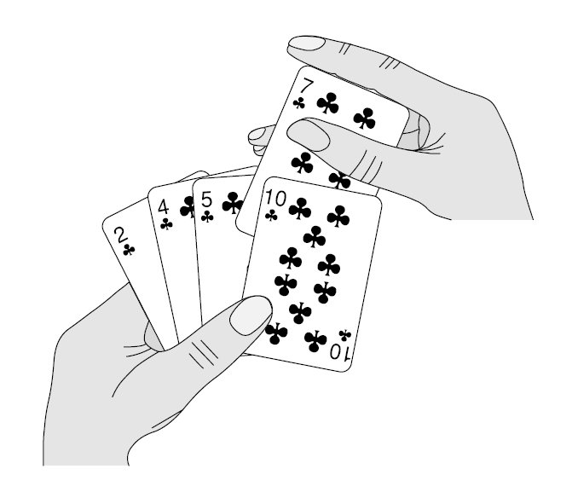
Insertion Sort

Slide 5
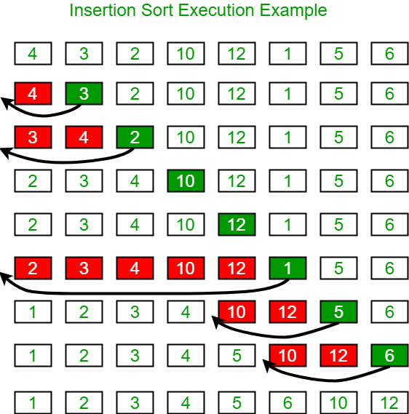
Insertion Sort
Pseudocode
i ← 1
while i < length(A)
j ← i
while j > 0 and A[j-1] > A[j]
swap A[j] and A[j-1]
j ← j - 1
end while
i ← i + 1
end while

Slide 6
Selection Sort

Slide 7
Bubble Sort

Slide 8
Divide and Conquer
Sorting and Searching

Slide 9
Merge sort

Slide 10
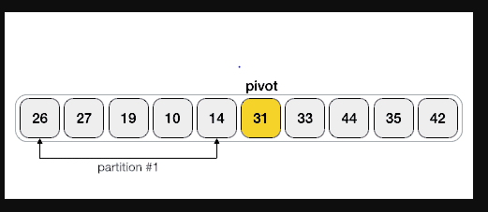
Quick sort

Slide 11
Searching Algorithm
Sorting and Searching

Slide 12
Sequential search

